Slide 1
Casting of Death
Creative Co-production #3
Domestic Research Society
Ljubljana, Slovenia

Slide 2
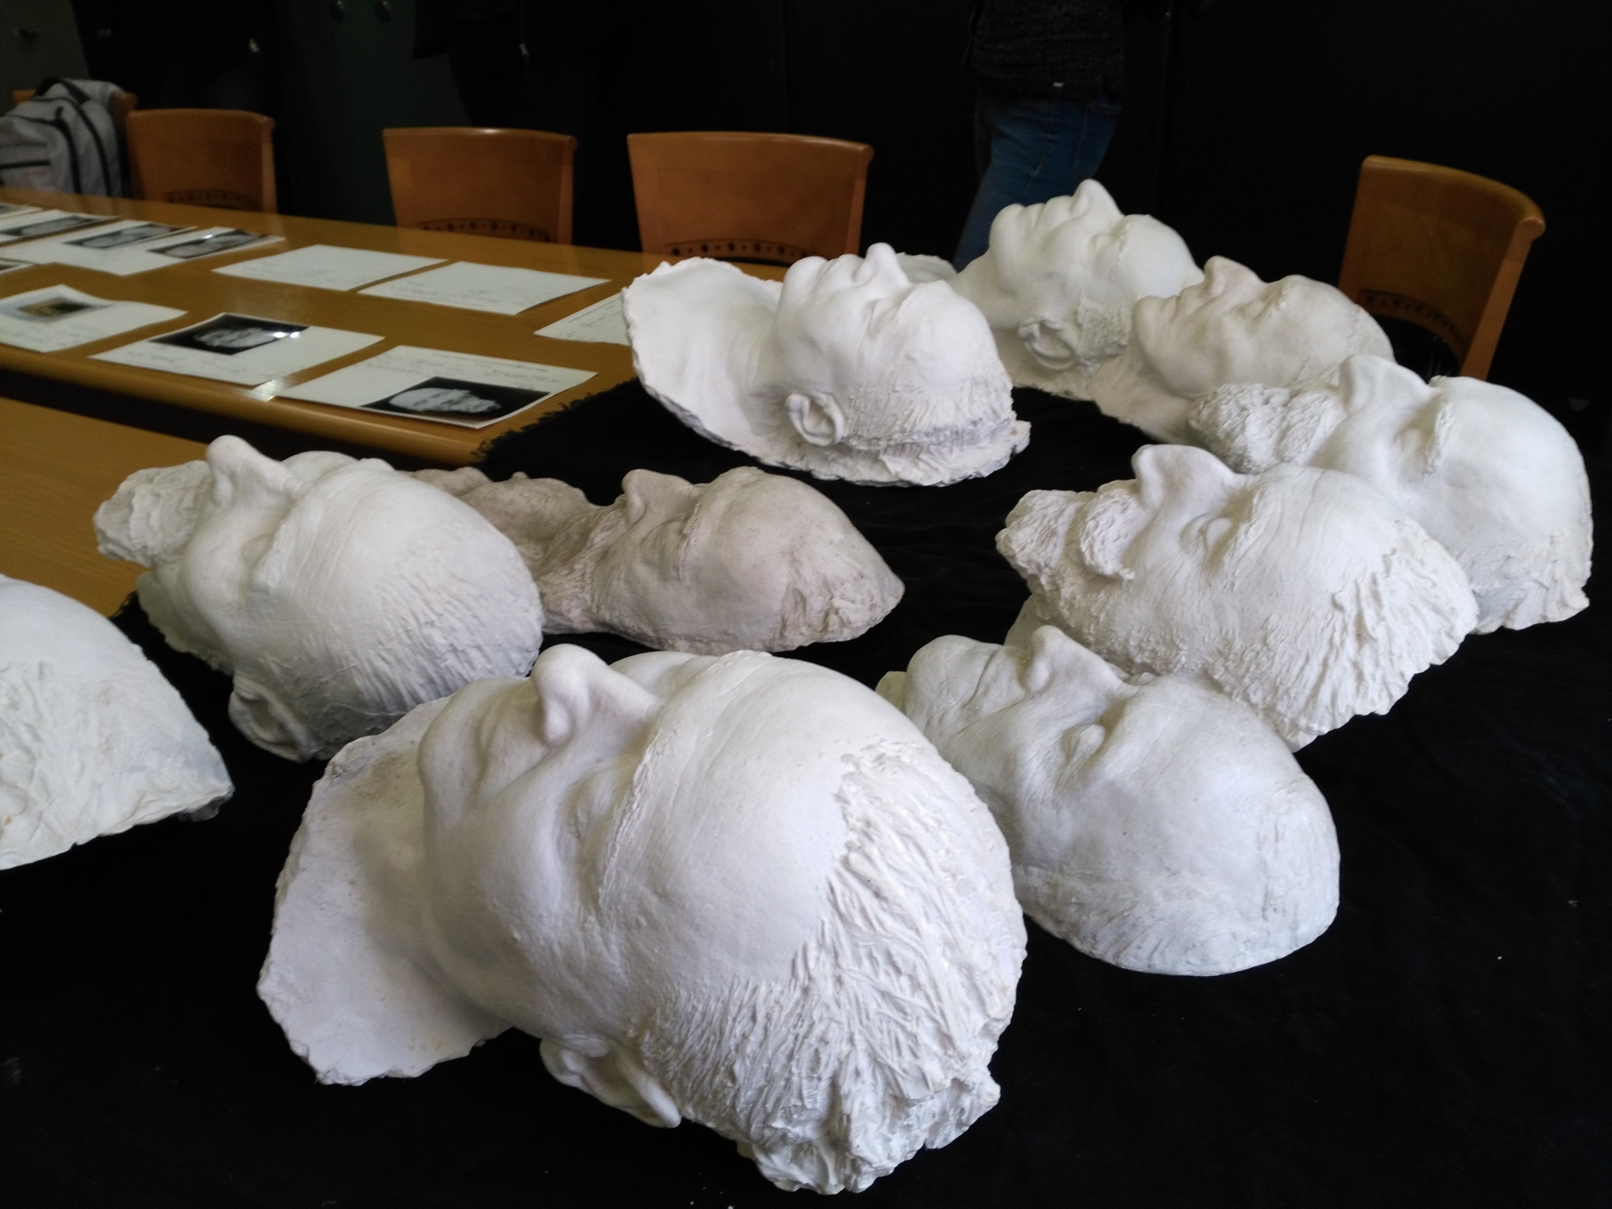
Slovene Academy of Sciences and Arts, 30 March 2017
Notes:
Tukaj kolege spomnimo, da se ukvarjamo s posmrtnimi maskami v slovenskih javnih zbirkah.

Slide 3
Casting of Death
Death masks | INNITIAL QUESTIONS
Is this technique of representation really obsolete?
Has the role of the artist (the one who took the casts and was cast himself when he died) changed or can it still be traced in the activities of a contemporary visual artist?
Notes:
Tukaj kolege spomnimo na naša izvorna vprašanja.

Slide 4
CCP3 methodology 1/2
INTERNAL
interdisciplinary working sessions
data collecting (118 institutions, so far 54 % response) & depot visits (11)
field research on contemporary casting practices
hybrid records
topical workshops (WP1, WP2, Institute of contemporary history)
Notes:
Povemo, kako delamo: interne metode

Slide 5
CCP3 methodology 2/2
PUBLIC
online archive of the death masks on the sistory.si portal
blog as a common platform
public press conference
exhibition in an art gallery
OPEN FORMATS
> structured and used as conventional formats
> open as they constitute the research itself and serve as a public trial not as a representation
Notes:
Povemo, kako delamo: javne metode kot odprte platforme! Ni placa, da bi dodala alinejo za ohranjanje ekipe v kondiciji. Mogoče ni tako pomembno?

Slide 6
Future activities CCP3
Research:
field trips (casting of death masks in 21st century)
database development
Events:
Casting of Death exhibition & related events 1 November 2017, The Match Gallery, Ljubljana.
Involving larger audience through a series of events on different scales, invented together with the colleagues from the 3 heritage institutions (DIWO).
Notes:
Povemo, v kateri fazi smo zdej

Slide 7
Reflexive Europeanisation
Artists as cultural saints
Notes:
Gremo iz big picture navzdol – najprej nekaj ugotovitev iz naše baze, ki se navezujejo na evropeizacijo in velike teme

Slide 8
Artists as cultural saints
The artists have remained most suitable for a post-mortem exploitation in order to build or strengthen the nation.

Slide 9
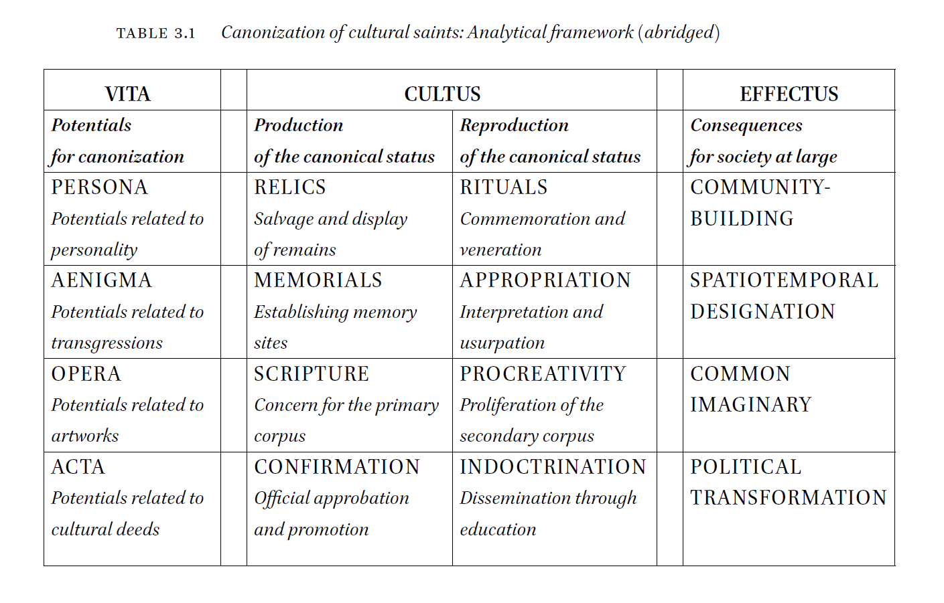
National Poets, Cultural Saints: Canonization and Commemorative Cults of Writers in Europe by Marijan Dović, ZRC SAZU Institute of Slovenian Literature and Literary Studies, and Jón Karl Helgason, University of Iceland. Brill 2016.
Notes:
Leva puščica: posmrtne maske so med relikvijo in spomenikom; Desna: delovanje CCP3 je med apropriacijo in prokreativnostjo (novo umetniško delo / izjava …).

Slide 10
Creative co-production
What is it actually? The CCP3 case.
Notes:
Iz evropske perspektive se spustimo na nivo konkretne CCP

Slide 11
CCP3 in Ljubljana, Slovenia
CREATIVE CO-PRODUCTION #3
Domestic Research Society Damijan Kracina, Alenka Pirman, Jani Pirnat
+ documentalist Maruša Kocjančič
ethnographer Blaž Bajič (WP2, University Oslo)
In close collaboration with
Marijan Rupert (National and University Library)
Marko Jenko (Museum of Modern Art)
Janez Polajnar (City Museum of Ljubljana)
Andrej Pančur (Institute of Contemporary History)
Notes:
Povemo, da se iz takih seznamov ne vidi razmerij. Ponovimo, da je point TRACES vloga umetnika – kje je, kakšna je?

Slide 12
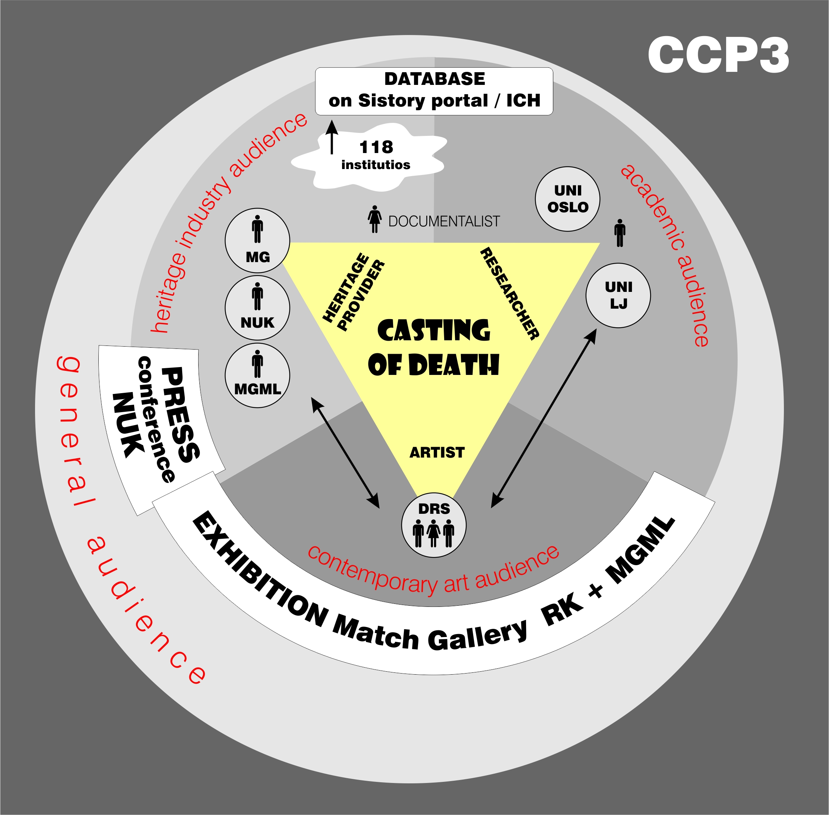
Notes:
Razložimo, da nas je zanima odnos MED POSAMEZNIKI (experts), INSTITUCIJAMI in OBČINSTVI (kako jih doseči in v kakšnem bubblu se pravzaprav nahajamo)

Slide 13
CCP on a field trip
How does it work in practice?
Notes:
Iz evropske perspektive se spustimo na nivo konkretne CCP

Slide 14
Field trip to the death-mask maker Viktor Gojkovič
- Getting out of a comfort zone
Moving field research from institutional frame to contemporary practice of casting dead masks
- Creative Co-production on the field
Artists, ethnographer, historian, art historian and Viktor Gojkovič‘s relative joining expertise and creating safe environment for collaboration with the sculptor who casts the death masks
- Contentiousness of contemporary death-mask making How much do we know about death and dead body and are we as society today alienated from the experiences and this fills us with unease and piety. Is there anything problematic in how the handling of a dead body is performed by the sculptors or pathology and morgue staff? Do anecdotes on various situations of casting the death masks regarding the decay of the body and handling make practice contentious?

Slide 15
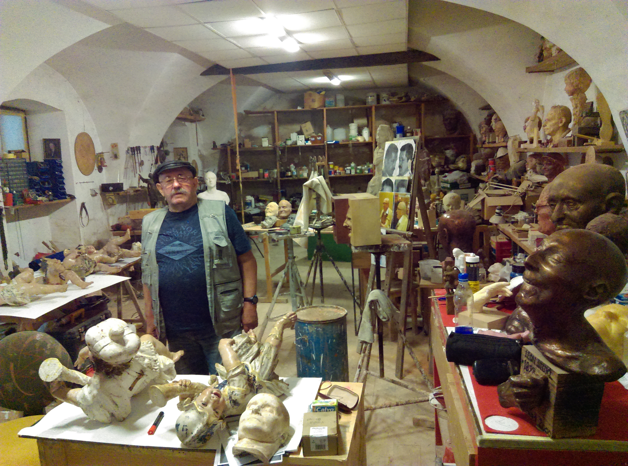
Notes:
Poveš, kdo je majster in kolk jih je že odlil

Slide 16
Teasers for the workshops
1) COPRODUCTION & PUBLIC FORMATS vs ARTISTIC VISUALISATION (> WP1)
Is the artwork obsolete?
2) ENCOUNTERS WITH DIFFICULT COLLECTIONS (> WP3+5)
Contemporary death-mask casting: CCP3 goes out of comfort zone.
3) REFLEXIVE EUROPEANISATION (> WP4+5)
‚Successful‘ decolonisation & artists as cultural saints.
4) MAKING SENSE OF FIELD MATERIALS; ETHNOGRAPHIC METHODS (> WP2+4).
Challenging the artist‘s role: Artist as a producer & facilitator.
Notes:
Tukaj povemo, kaj nas zanima predebatirat na delavnicah (in malo provociramo).

Slide 17
Thank you.
Creative Co-production #3
Domestic Research Society
http://ddr.si/en/category/projects/casting-of-death/
info@ddr.si

